Slide 1

Online Movie Ticket Booking
by Shubham Negi
FINISH

Slide 2







Abstract
Interactive Front-End: Developed using Angular to provide a responsive and engaging user interface for seamless movie ticket booking.
Search and Filter: Users can search for movies and apply various filters to refine their search results, enhancing the user experience.
Multiple Payment Methods: Integration of various payment options, including credit/debit cards, digital wallets, and net banking, for user convenience.
Email Confirmation: An automated email service sends booking confirmation and payment receipt to users upon successful transaction.
Security and Scalability: Emphasis on security, performance, and scalability to ensure a reliable and efficient booking system.

Slide 3
Module
1. User Module
Registration & Login
2. Movie Module
Movie Listings
Search & Filter
3. Booking Module
Seat Selection
Booking Confirmation
Payment Gateway

Slide 4
Software Requirement
Operating system : Windows 10/11.
Coding Language : C#.net,
Frontend : ASP.Net Core, WEB API, HTML, CSS, JavaScript, JQuery, Angular 17
IDE Tool : Visual Studio code ,Visual Studio .Net, PostMan/ Webstorm
Database : SQL SERVER 2019.

Slide 5
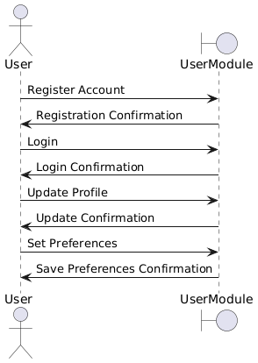
Sequence Diagram 1.1

Slide 6
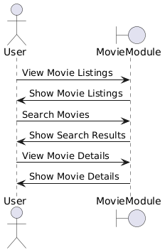
Sequence Diagram 1.2

Slide 7
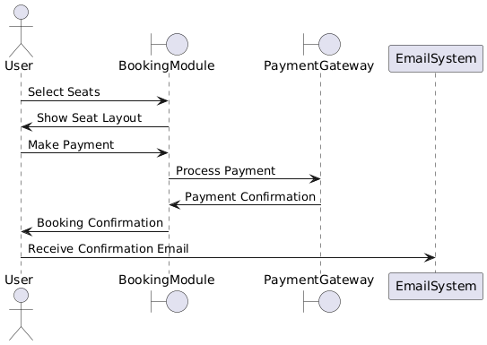
Sequence 1.3

Slide 8
FUNCTIONALITIES
Search and Filter: Users can search for movies and apply various filters to refine their search results, enhancing the user experience.
Payment Gateway: Integrates with various payment systems to process ticket purchases securely.
Booking Confirmation: Sends booking confirmations via email or SMS and generates QR codes for ticket verification.

Slide 9
THANK YOU

